Slide 1
Unit 5
Probabilistic Methods

Slide 2
Contents
Introduction to Probabilistic Reasoning
Bayes and Markov Network, DBN’s and HMN’s

Slide 3
Introduction to Probabilistic Reasoning
One of the most common characteristics of the human information available is its imperfection due to partial observability, non deterministic or combination of both
An agent may not know what state it is in or will be after certain sequence of actions
Agent can cope with these defects and make rational judgments and rational decisions to handle such uncertainty and draw valid conclusions

Slide 4
Introduction to Probabilistic Reasoning
What is uncertainty?
The lack of the exact knowledge that would enable us to reach a perfectly reliable conclusion
Classical Logic permits only exact reasoning i.e. perfect knowledge always exists
In Real world such clear cut knowledge could not be provided to systems
IF A is true THEN A is not false | and | IF B is true THEN B is not false

Slide 5
Introduction to Probabilistic Reasoning
Sources of Uncertain Knowledge
Weak Implication: Domain experts and knowledge engineer have rather painful or hopeless task of establishing concrete correlation between IF(Condition) and THEN(action) part of rules. Vague Data.
Imprecise Language : NLP is ambiguous and imprecise. We define facts in terms of often, sometimes, frequently, hardly ever. Such can affect IF-THEN implication
Unknown Data: incomplete and missing data should be processes to an approx. reasoning with this values
Combining the views of different experts: Large system uses data from many experts

Slide 6
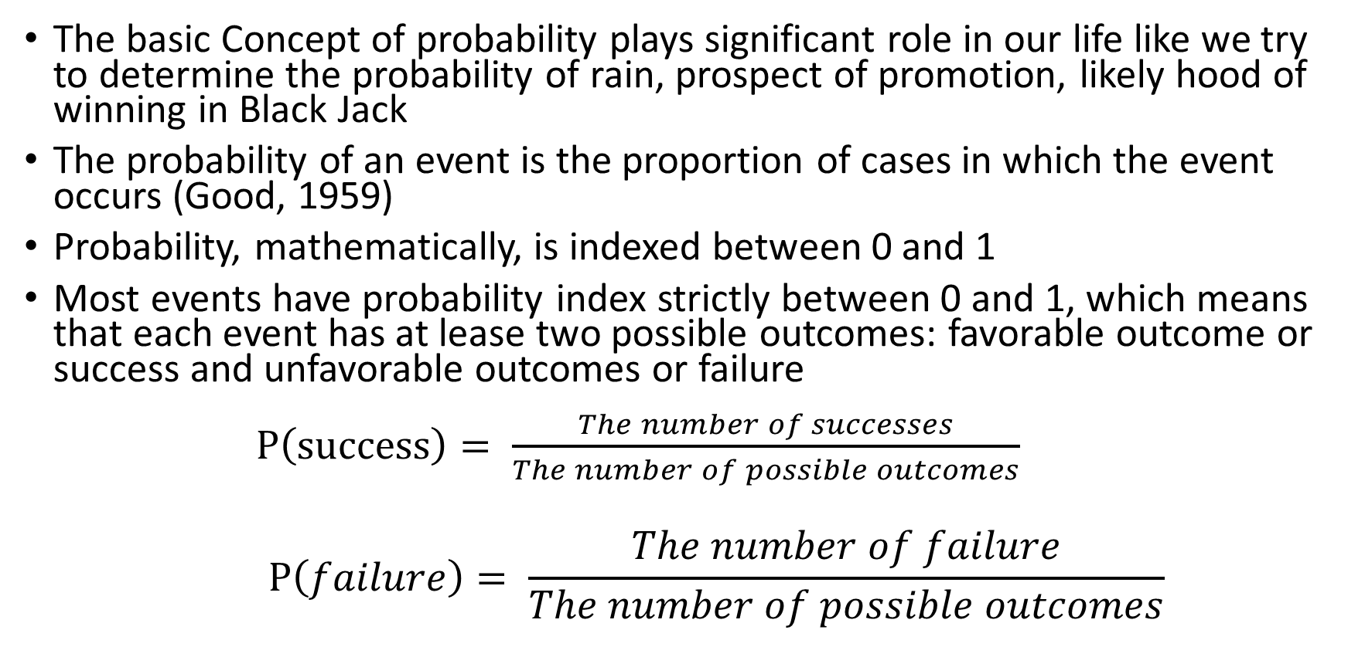
Introduction to Probabilistic Reasoning
The basic Concept of probability plays significant role in our life like we try to determine the probability of rain, prospect of promotion, likely hood of winning in Black Jack
The probability of an event is the proportion of cases in which the event occurs (Good, 1959)
Probability, mathematically, is indexed between 0 and 1
Most events have probability index strictly between 0 and 1, which means that each event has at lease two possible outcomes: favorable outcome or success and unfavorable outcomes or failure $P\left(success\right)= \frac{The number of successes}{The number of possible outcomes}$
$$P\left(failure\right)= \frac{The number of failure}{The number of possible outcomes}$$

Slide 7

Introduction to Probabilistic Reasoning
If s is the number of success and f is the number of failure then:
$P\left(success\right)= \frac{s}{s+f}$
$P\left(failure\right)= \frac{f}{s+f}$
and
p + q = 1

Slide 8
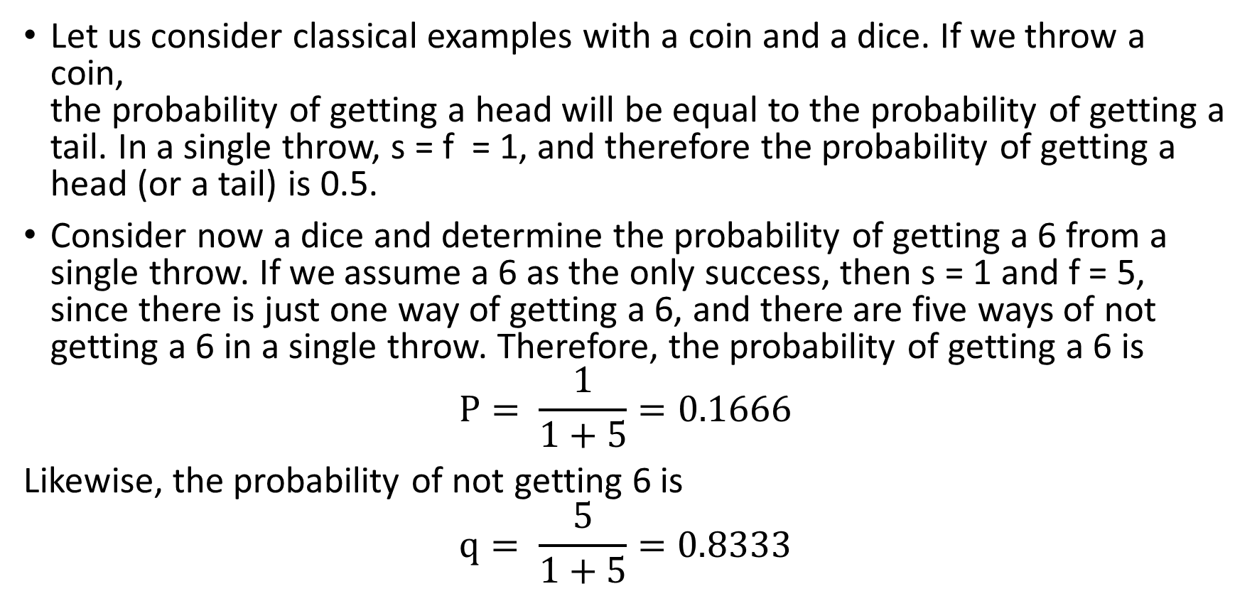
Introduction to probabilistic Reasoning
Let us consider classical examples with a coin and a dice. If we throw a coin, the probability of getting a head will be equal to the probability of getting a tail. In a single throw, s = f = 1, and therefore the probability of getting a head (or a tail) is 0.5.
Consider now a dice and determine the probability of getting a 6 from a single throw. If we assume a 6 as the only success, then s = 1 and f = 5, since there is just one way of getting a 6, and there are five ways of not getting a 6 in a single throw. Therefore, the probability of getting a 6 is
$$P= \frac{1}{1+5}=0.1666$$ Likewise, the probability of not getting 6 is
$$q= \frac{5}{1+5}=0.8333$$

Slide 9
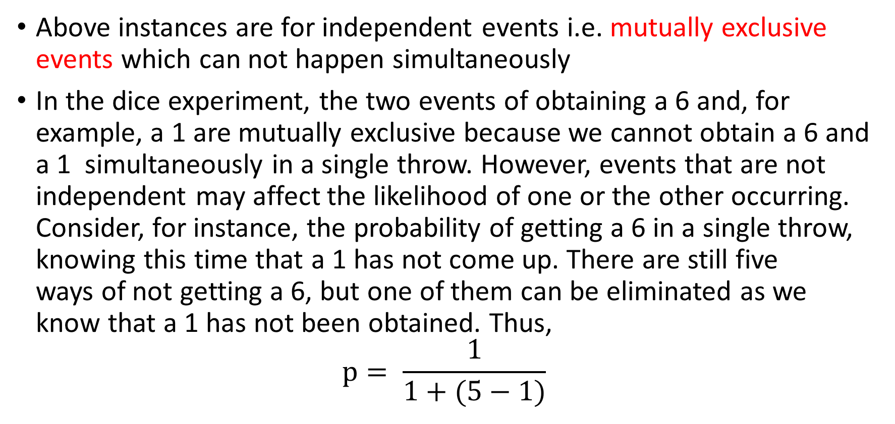
Introduction to Probabilistic Reasoning
Above instances are for independent events i.e. mutually exclusive events which can not happen simultaneously
In the dice experiment, the two events of obtaining a 6 and, for example, a 1 are mutually exclusive because we cannot obtain a 6 and a 1 simultaneously in a single throw. However, events that are not independent may affect the likelihood of one or the other occurring. Consider, for instance, the probability of getting a 6 in a single throw, knowing this time that a 1 has not come up. There are still five ways of not getting a 6, but one of them can be eliminated as we know that a 1 has not been obtained. Thus,
$$p= \frac{1}{1+(5−1)}$$

Slide 10
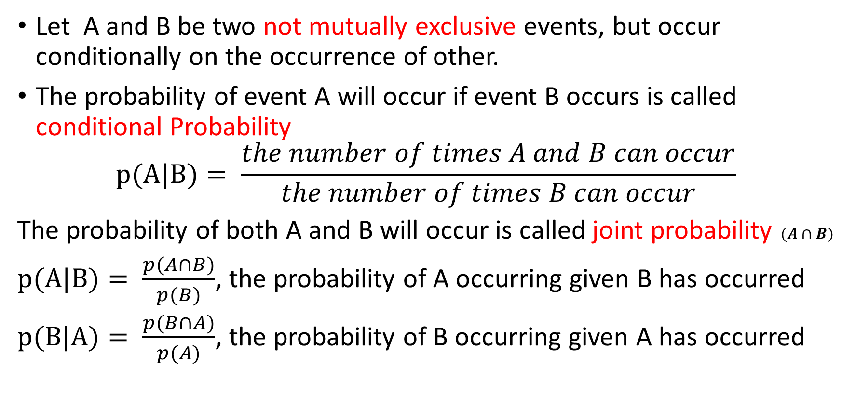
Introduction to Probabilistic Reasoning
Let A and B be two not mutually exclusive events, but occur conditionally on the occurrence of other.
The probability of event A will occur if event B occurs is called conditional Probability
$$p(A|B)= \frac{the number of times A and B can occur}{the number of times B can occur}$$
The probability of both A and B will occur is called joint probability $(A∩B)$
$p(A|B)= \frac{p(A∩B)}{p(B)}$, the probability of A occurring given B has occurred
$p(B|A)= \frac{p(B∩A)}{p(A)}$, the probability of B occurring given A has occurred

Slide 11
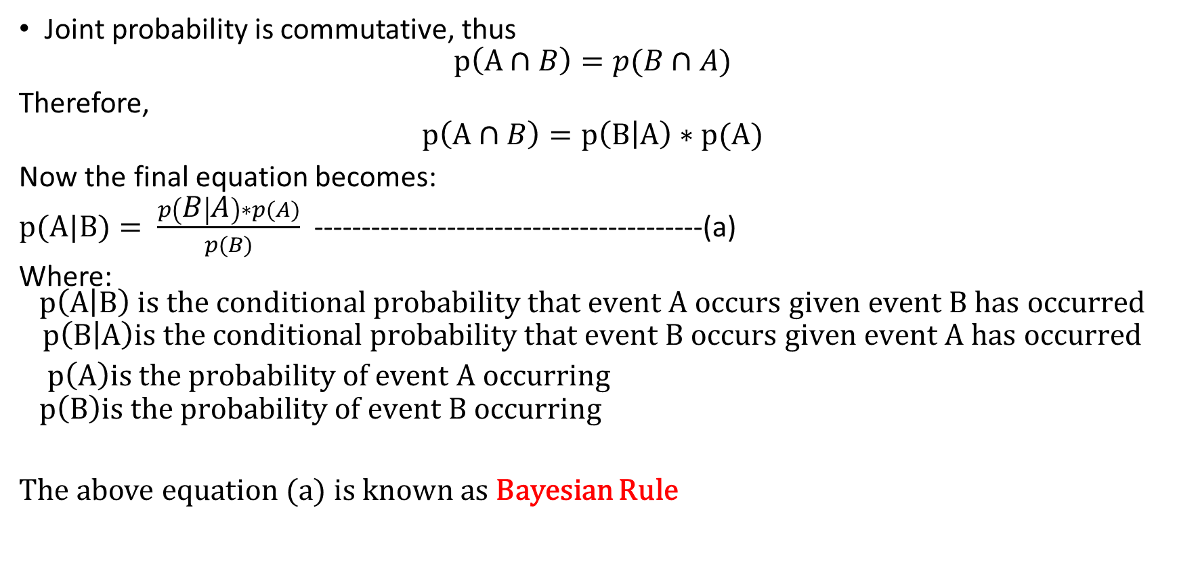
Introduction to Probabilistic Reasoning
Joint probability is commutative, thus
$$p\left(A∩B\right)=p(B∩A)$$
Therefore,
$$p\left(A∩B\right)=p\left(B | A\right)∗p(A)$$
Now the final equation becomes:
$p(A|B)= \frac{p\left(B | A\right)∗p(A)}{p(B)}$ -----------------------------------------(a)
Where: $$p\left(A | B\right) is the conditional probability that event A occurs given event B has occurred$$
$$p\left(B | A\right)is the conditional probability that event B occurs given event A has occurred$$
$p\left(A\right)is the probability of event A occurring$
$$p\left(B\right)is the probability of event B occurring$$
The above equation (a) is known as Bayesian Rule

Slide 12
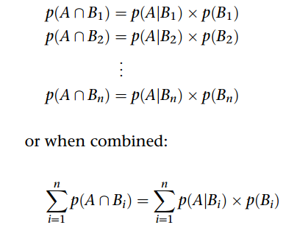
Introduction to Probabilistic Reasoning
For n number of mutually exclusive event B we have

Slide 13

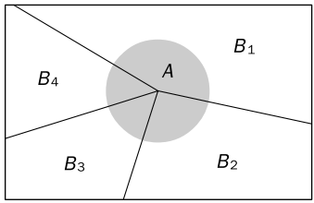

Introduction to Probabilistic Reasoning
Summed over an exhaustive list of events for Bi, we get :
Which reduces to:

Slide 14

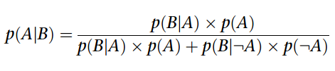
Introduction to Probabilistic Reasoning
If the occurrence of A depends on only two mutually exclusive events, i.e. B and NOT B, then above equation becomes
Similarly,
Substituting above equations in Bayesian Equation, We get:

Slide 15
THANK YOU

